Slide 1
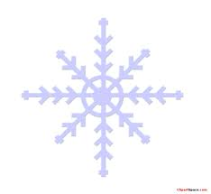
Winter Horses
by Caitlin Graham

Slide 2
What is a simile?
What is a metaphor?
Let’s review!

Slide 3
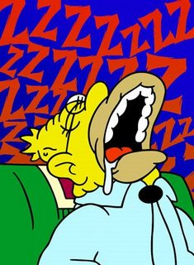
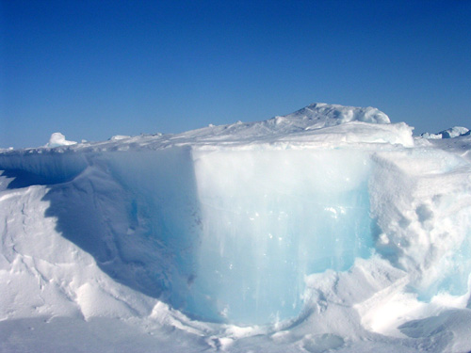
Last night, my bedroom was cold.
Last night, my bedroom was as cold as a glacier.
Boring!
Much more interesting!

Slide 4
What is a simile?
A simile is a type of figurative speech.
A simile is when you compare two unlike things by using the words “like” or “as”.
Even though the two things are unlike each other, they do have something in common that allows them to be compared to each other.
Good writers like to use similes because similes make their writing sizzle!

Slide 5
Let’s make our writing sizzle!
Instead of…”Last night, my bedroom was cold.”
Last night, my bedroom was as cold as a glacier.
Comparing
to
How are they alike?
They’re both cold!

Slide 6
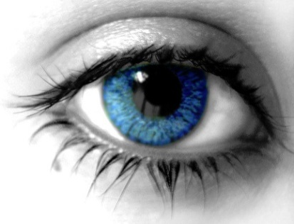
Let’s make our writing sizzle!
Instead of…”She had blue eyes.”
Her eyes were as blue as the tropical ocean waters.
Comparing
to
How are they alike?
They’re both blue!

Slide 7
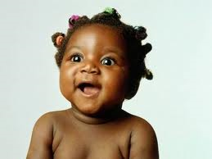
Let’s make our writing sizzle!
Instead of…”The baby had a nice smile.”
The baby’s smile was bright like the morning sunshine.
Comparing
to
How are they alike?
They’re both bright!

Slide 8
I like orange juice the best.
The dog’s bark was as loud as an explosion.
Please be quiet as you come into the room.
The excited kindergartner hopped down the hall like a frog.
My cat does not like my dog very much.
The sheep’s fleece was as white as snow.

Slide 9
C1 - Find the simile in the poem and write it on your ladder.

Slide 10
“A storm approaches like a band of wild colts.”

Slide 11
A metaphor is a direct comparison between two unlike things. It does not use the words like or as.
http://library.thinkquest.org/J0112392/metaphor.html
Tom is a sly fox means
Tom is clever and perhaps sneaky.

Slide 12
Identify the four metaphors in the poem.

Slide 13
“twisted tails an flying forelegs are oak leaves dancing in the breeze.”
“shaking manes and flashing heels are just snowflakes laughing at the wind”
“defiant whinnies are only the trees shuddering against the cold”
“frost that clings to the grass is the lingering dust of their passage.”

Slide 14
C2
What evidence from the poem suggests that winter is only temporary?

Slide 15
Words like “are only” and “are just” suggest something that is not serious and not permanent.
Words like clinging suggest something that is holding on for as long as it can.

Slide 16
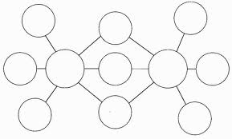
C3
Select an animal to represent another season.
Describe the qualities of the animal and the season in a double bubble map.

Slide 17
C3
Create a poem that compares the two, using “Winter Horses” as a model.
Title your poem so it reflects a central idea.

